Slide 1
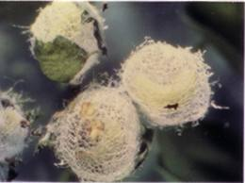
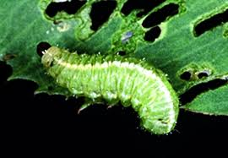
Alfalfa Weevil
Economic Impact
Vegetative Destruction (052)
Life Cycle
Complete Metamorphosis (1)
Mouth Parts
Chewing (070)

Slide 2
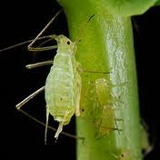
Aphids
Economic Impact
Removal of fluids (053)
Life Cycle
Incomplete Metamorphosis (002)
Mouthparts
Piercing-sucking (073)

Slide 3
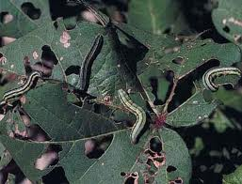
Army worm larva
Economic Impact
Vegetative Destruction ((052)
Life Cycle
Complete Metamorphosis (001)
Mouthparts
Chewing (070)

Slide 4
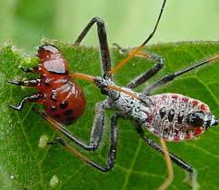
Assassin Bug
Economic Impact
Predatory (050)
Life Cycle
Incomplete Metamorphosis (002)
Mouthparts
Piercing-Sucking (073)

Slide 5
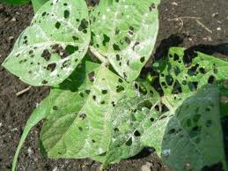
Bean Leaf Beetle
Economic Impact
Vegetative Destruction (052)
Life Cycle
Complete Metamorphosis (001)
Mouthparts
Chewing (070)

Slide 6
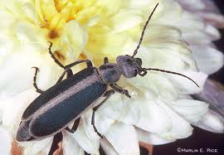
Blister Beetle
Economic Impact
Vegetative Destruction (052)
Life Cycle
Complete Metamorphosis (001)
Mouthparts
Chewing (070)

Slide 7
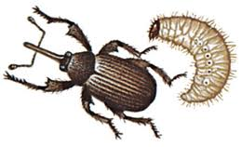
Boll Weevil
Economic Impact
Fruit/Flower Destruction (051)
Life Cycle
Complete Metamorphosis (001)
Mouthparts
Chewing (070)

Slide 8
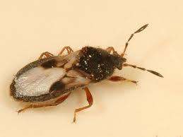
Chinch Bug
Economic Impact
Removal of fluids (053)
Life Cycle
Incomplete Metamorphosis (002)
Mouthparts
Piercing-Sucking(073)

Slide 9
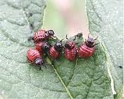
Colarado Potato Beetle
Economic Impact
Vegetative Destruction (052)
Life Cycle
Complete Metamorphosis (001)
Mouthparts
Chewing (070)

Slide 10
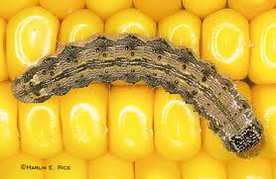
Corn Ear Worm Larva
Economic Impact
Fruit/Flower Destruction (051)
Life Cycle
Complete Metamorphosis (001)
Mouthparts
Chewing (070)

Slide 11
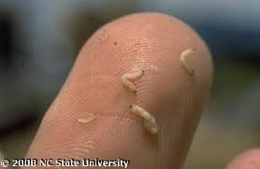
Corn Rootworm Larva
Economic Impact
Vegetative Destruction (052)
Life Cycle
Complete Metamorphosis (001)
Mouthparts
Chewing (070)

Slide 12
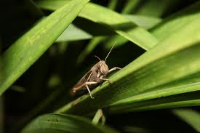
Cricket
Economic Impact
Predatory (050)
Life Cycle
Incomplete Metamorphosis (002)
Mouthparts
Chewing (070)

Slide 13
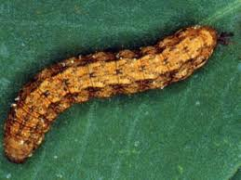
Cutworm Larva
Economic Impact
Vegetative Destruction (052)
Life Cycle
Complete Metamorphosis (001)
Mouthparts
Chewing (070)

Slide 14
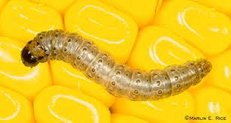
European Corn Borer Larva
Economic Impact
Vegetative Destruction (052)
Life Cycle
Complete Metamorphosis (001)
Mouthparts
Chewing Mouthparts (070)

Slide 15
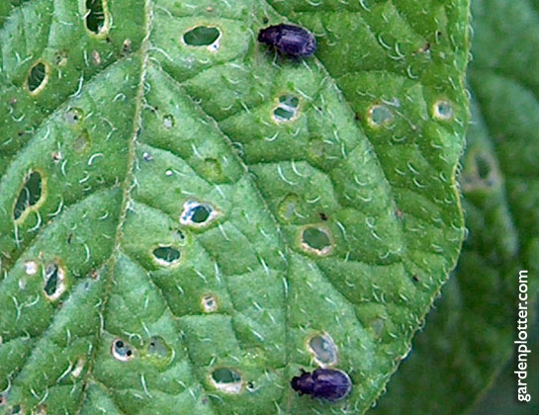
Flea Beetle
Economic Impact
Vegetative Destruction (052)
Life Cycle
Complete Metamorphosis (001)
Mouthparts
Chewing Mouthparts (070)

Slide 16
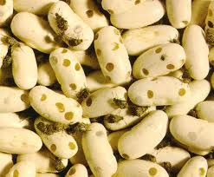
Grain Weevil
Economic Impact
Fruit/Flower Destruction (051)
Life Cycle
Complete Metamorphosis (001)
Mouthparts
Chewing (070)

Slide 17
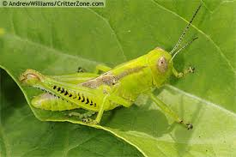
Grasshopper
Economic Impact
Vegetative Destruction (052)
Life Cycle
Incomplete Metamorphosis (002)
Mouthparts
Chewing (070)

Slide 18
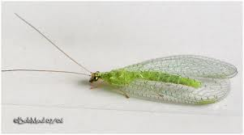
Green Lacewing
Economic Impact
Predatory (050)
Life Cycle
Complete Metamorphosis (001)
Mouthparts
Chewing Mouthparts (070)

Slide 19
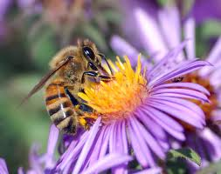
Honeybee
Economic Impact
None or predatory (050)
Life Cycle
Complete Metamorphosis (001)
Mouthparts
Chewing-Lapping (071)

Slide 20
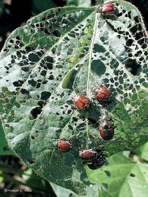
Japanese Beetle
Economic Impact
Vegetative Destruction (052)
Life Cycle
Complete Metamorphosis (001)
Mouth Part
Chewing (070)

Slide 21
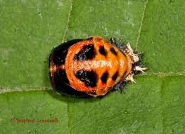
Lady Beetle Larva
Economic Impact
Predatory (050)
Life Cycle
Complete (001)
Mouthparts
Chewing (070)

Slide 22
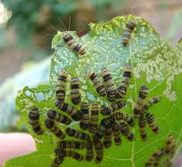
Leaf Skeletonizer
Economic Impact
Vegetative Destruction (052)
Life Cycle
Complete Metamorphosis (001)
Mouthparts
Chewing (070)

Slide 23
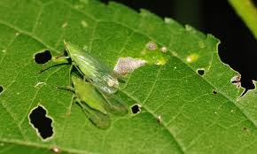
Leaf Hopper
Economic Impact
Removal of fluids (053)
Life Cycle
Incomplete Metamorphosis (002)
Mouthparts
Piercing-Sucking (073)

Slide 24
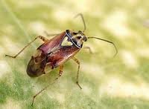
Lygus
Economic Impact
Removal of fluids (053)
Life Cycle
Incomplete Metamorphosis (002)
Mouthparts
Piercing-Sucking (073)

Slide 25
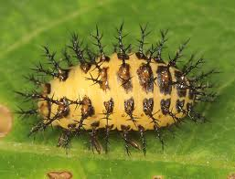
Mexican Bean Beetle
Economic Impact
Vegetative Destruction (052)
Life Cycle
Complete Metamorphosis (001)
Mouthparts
Chewing (070)

Slide 26
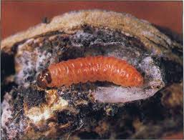
Pink Bollworm Larva
Economic Impact
Fruit/Flower Destruction (051)
Life Cycle
Complete Metamorphosis (001)
Mouthparts
Chewing (070)

Slide 27
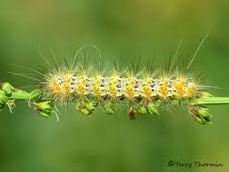
Salt Marsh Caterpillar/Wooly Worm
Economic Impact
Vegetative Destruction (052)
Life Cycle
Complete Metamorphosis (001)
Mouthparts
Chewing (070)

Slide 28
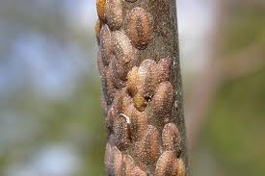
Scale
Economic Impact
Removal of fluids (053)
Life Cycle
Incomplete Metamorphosis (002)
Mouthparts
Piercing-sucking (073)

Slide 29
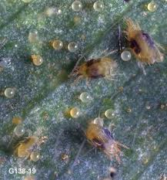
Spider Mite
Economic Impact
Removal of fluids (053)
Life Cycle
Incomplete Metamorphosis (002)
Mouthparts
Piercing-sucking (073)

Slide 30
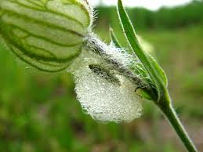
Spittlebug
Economic Impact
Removal of fluids (053)
Life Cycle
Incomplete Metamorphosis (002)
Mouthparts
Piercing-sucking (073)

Slide 31
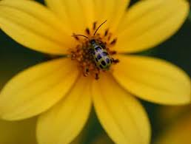
Spotted Cucumber Beetle/Southern Corn rootworm beetle
Economic Impact
Vegetative Destruction (052)
Life Cycle
Complete Metamorphosis (001)
Mouthparts
Chewing (070)

Slide 32
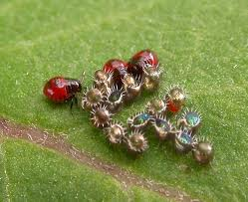
Stinkbug
Economic Impact
Removal of fluids (053)
Life Cycle
Incomplete Metamorphosis (002)
Mouthparts
Piercing-Sucking (073)

Slide 33
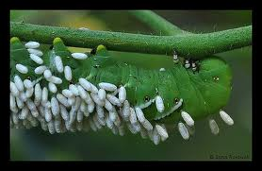
Tobacco/ Tomato Hornworm Larva
Economic Impact
Vegetative Destruction (052)
Life Cycle
Complete Metamorphosis (001)
Mouthparts
Chewing (070)

Slide 34
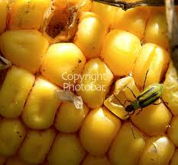
Western Corn Rootworm Beetle
Economic Impact
Vegetative Destruction (052)
Life Cycle
Complete Metamorphosis (001)
Mouthparts
Chewing (070)

Slide 35
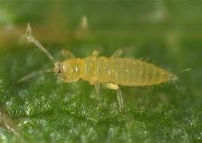
Western Flower Thrip
Economic Impact
Vegetative Destruction
Life Cycle
Complete Metamorphosis
Mouthparts
Chewing (070)

Slide 36
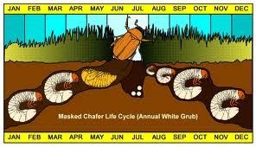
White Grub
Economic Impact
Vegetative Destruction (052)
Life Cycle
Complete Metamorphosis (001)
Mouthparts
Chewing (070)

Slide 37
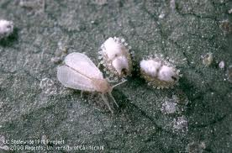
Whitefly
Economic Impact
Removal of fluids
Life Cycle
Complete Metamorphosis
Mouthparts
Rasping-Sucking (072)

Slide 38
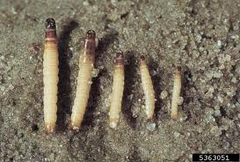
Wireworm
Economic Impact
Vegetative Destruction (052)
Life Cycle
Complete Metamorphosis
Mouthparts
Chewing (070)

